Slide 1
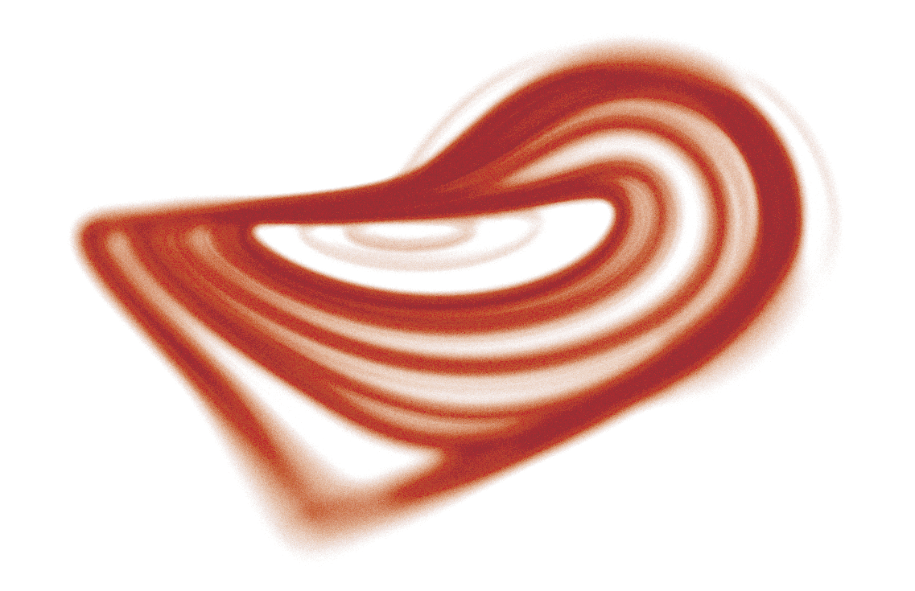


BS723
Machine Learning Applications in Architecture
CONTINUOUS MERGING OF
STRANGE ATTRACTORS using evolutionary algorithm
Ozgur Gulsuna ozgur.gulsuna@metu.edu.tr

Slide 2
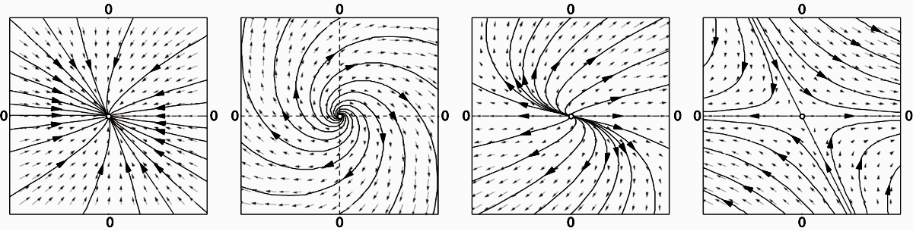
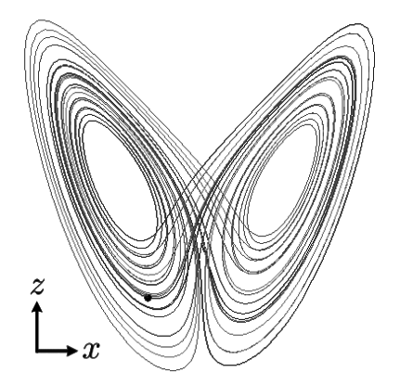
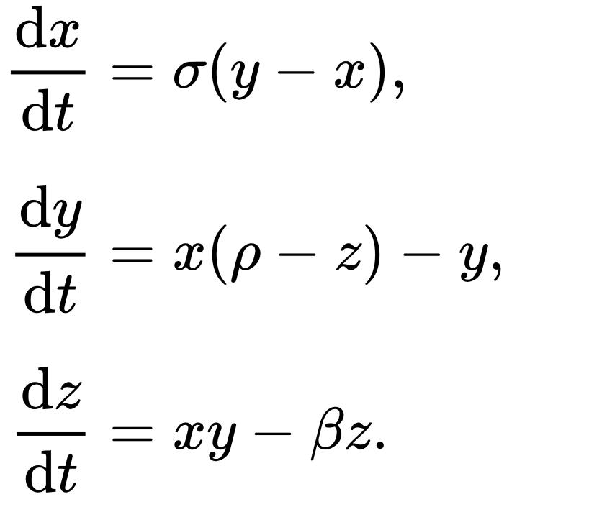
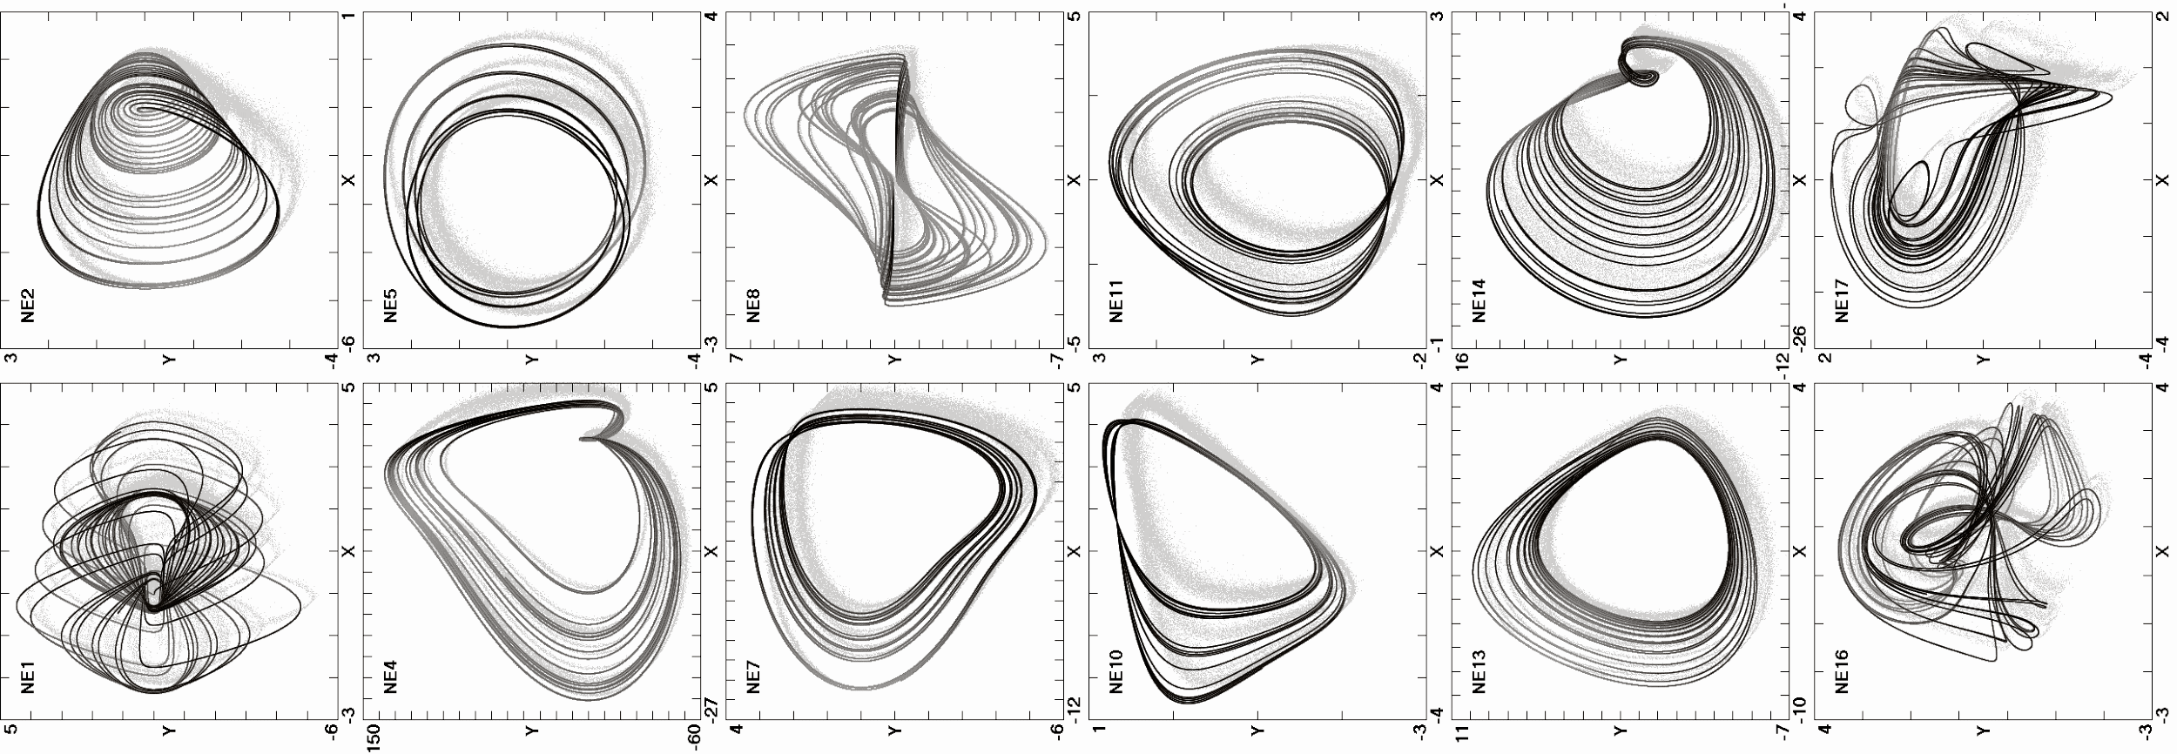
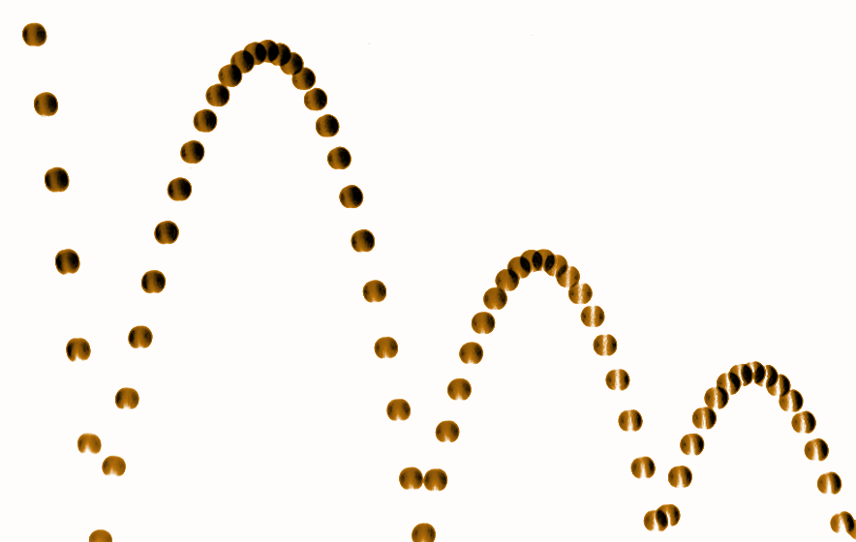
DYNAMICAL SYSTEMS chaotic systems
In mathematics, a dynamical system describes the time-dependent behavior of a point in space using a function.
Find/Create a new system
Find: Exploration in vast possibilities
Create: Combining systems together
FORM

Slide 3
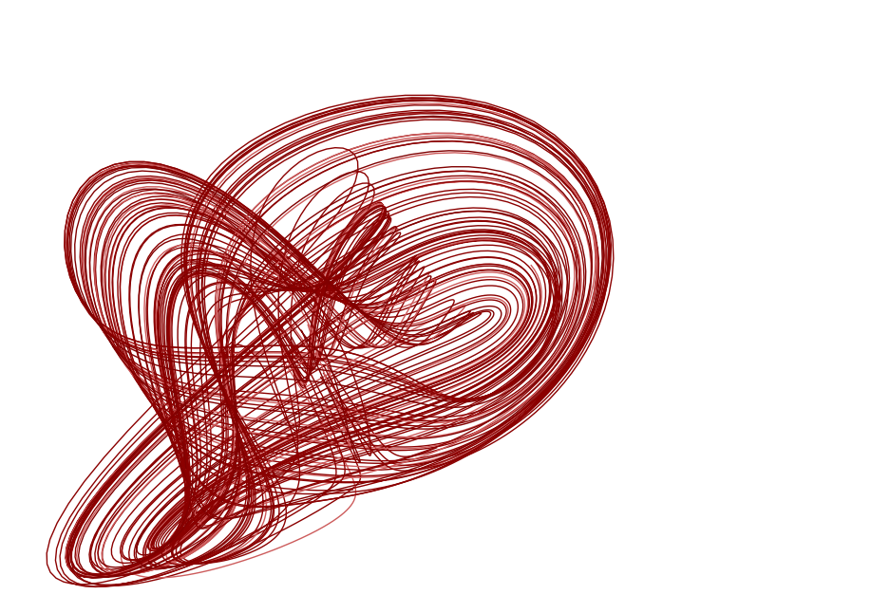
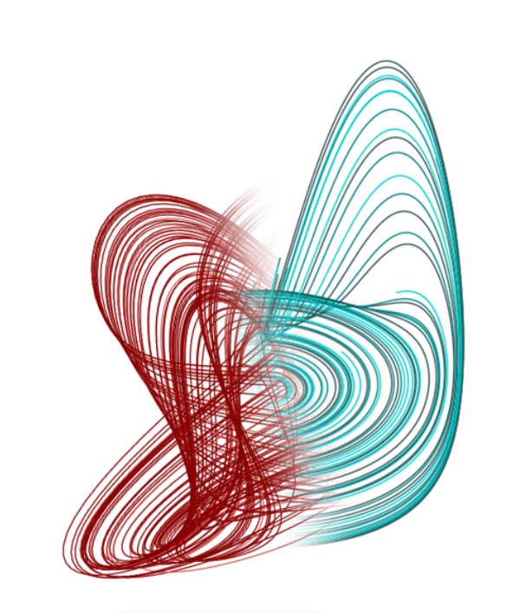
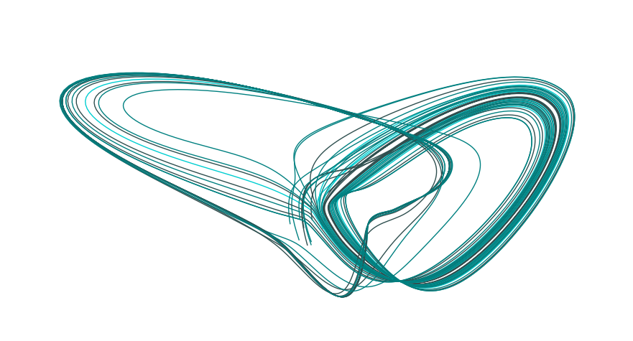
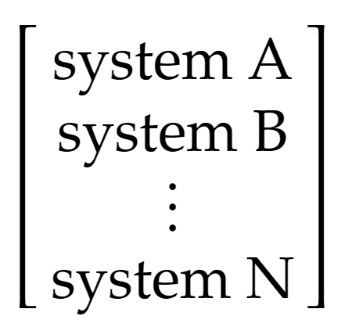
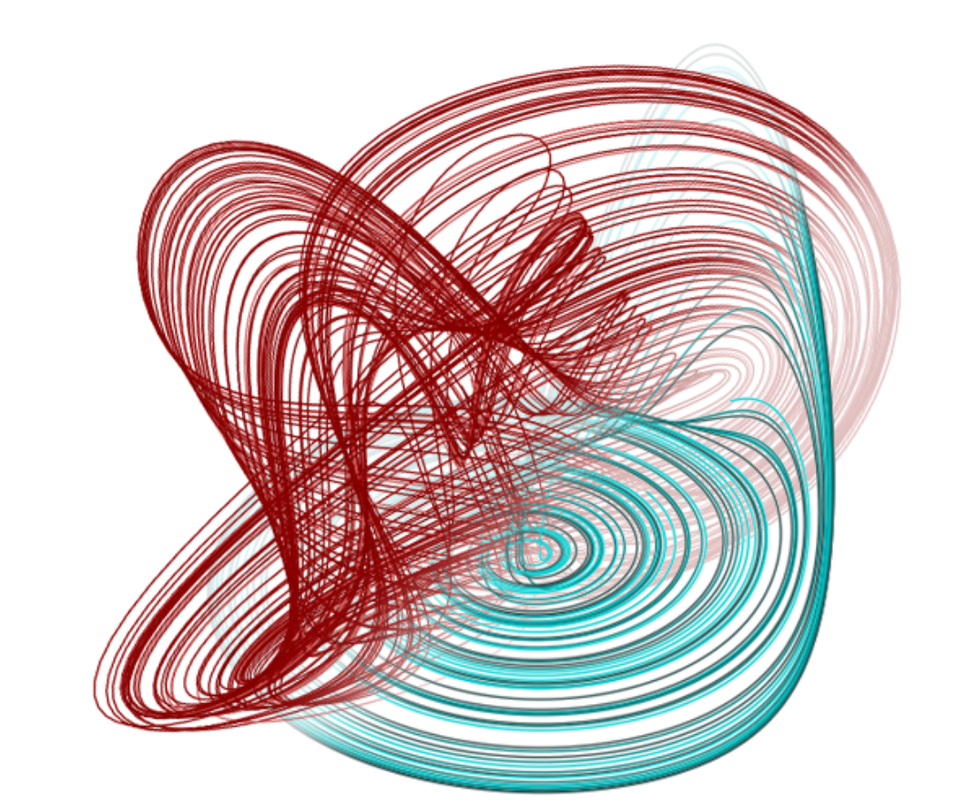
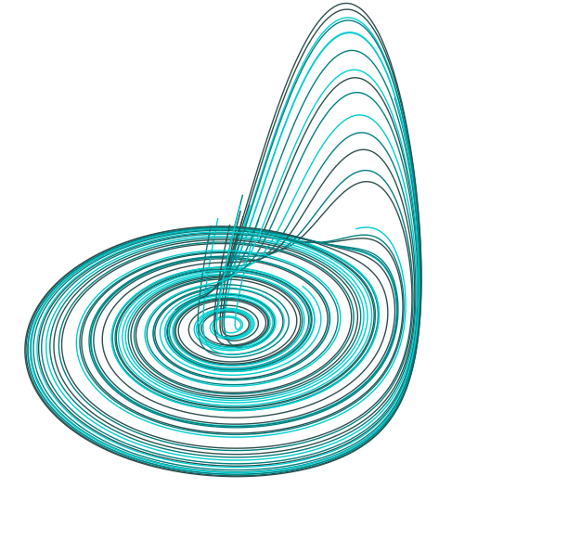
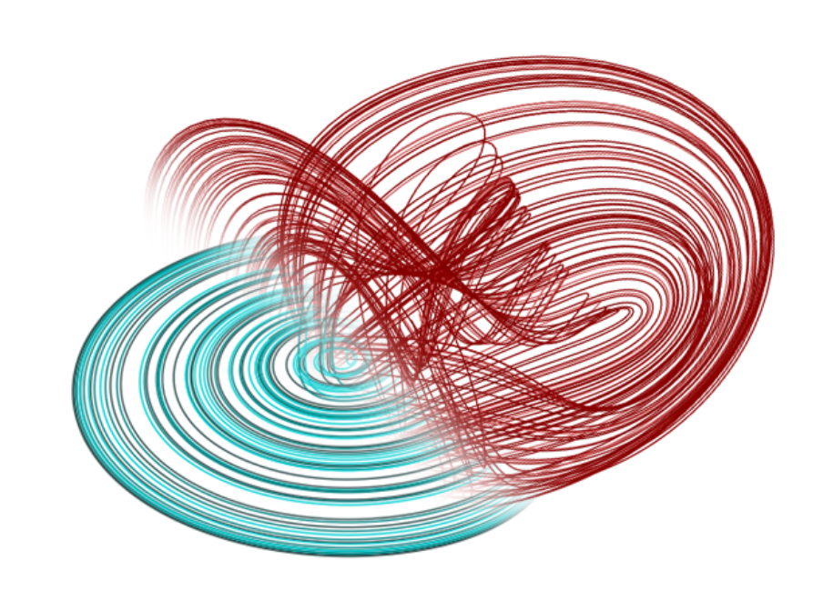
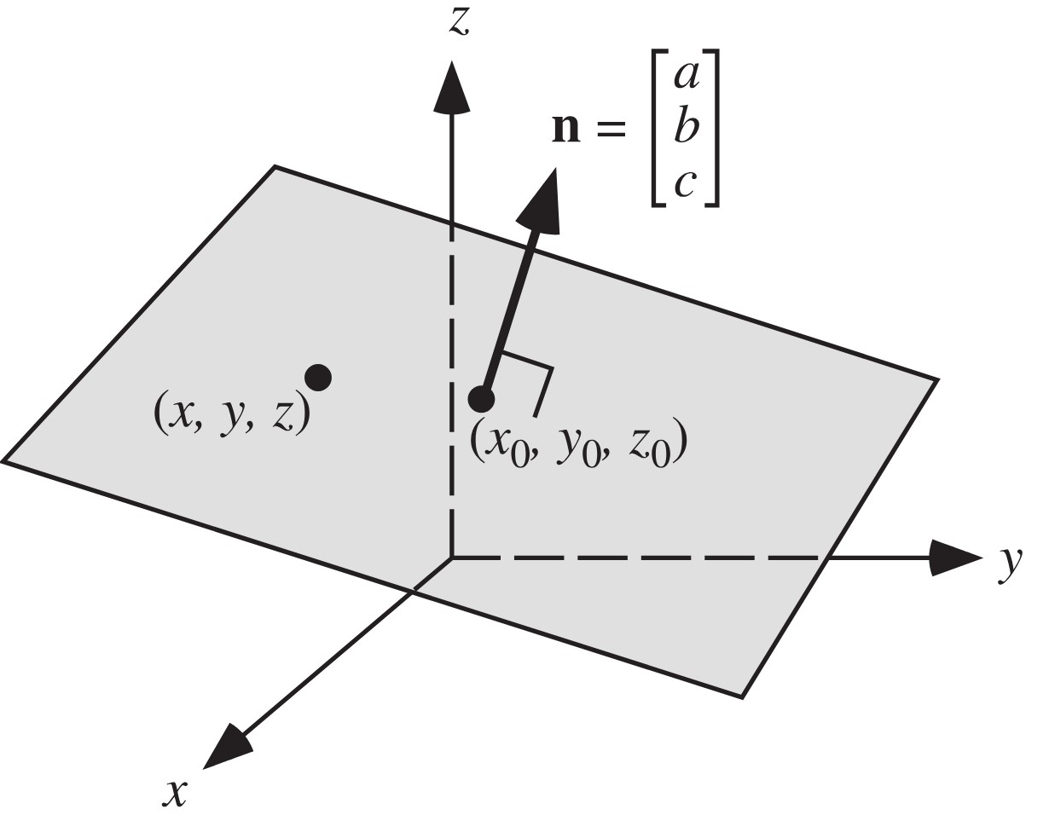
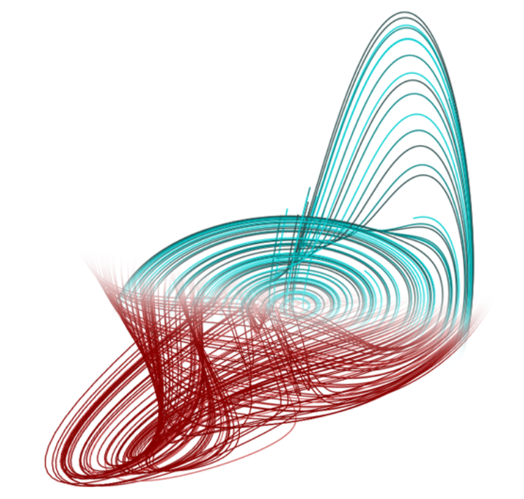
PROBLEM DEFINITION chaotic systems
Merge Systems w/ Smooth Transition
OBSERVATION
Prepare the Data
Evaluate
Find an Optimum Cutting Plane
since the two
systems are bounded,
some possible spatial combinations
can also be bounded, and perhaps chaotic.
MATERIAL
MODEL

Slide 4
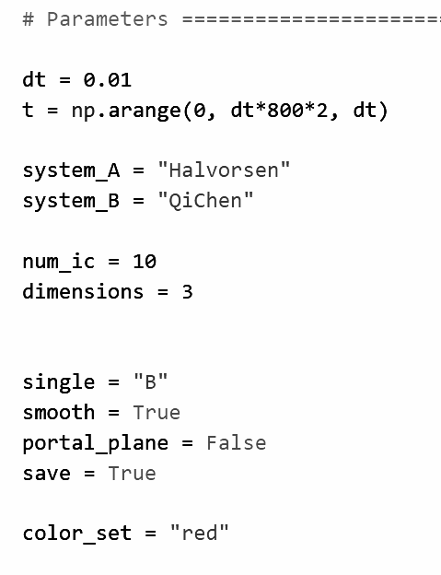
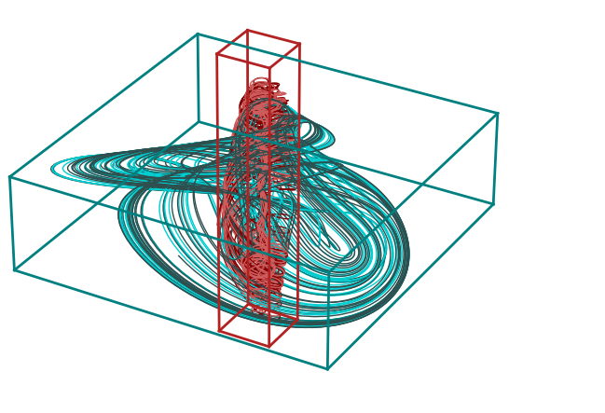
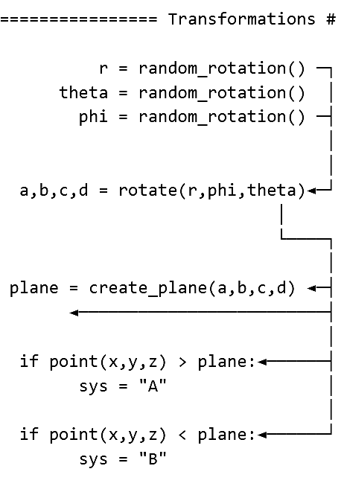
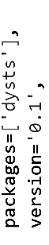
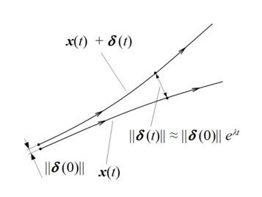
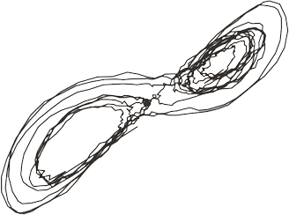
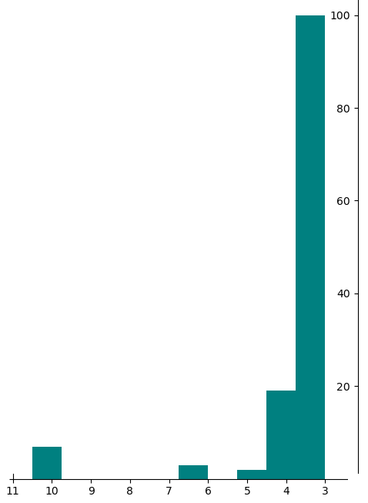
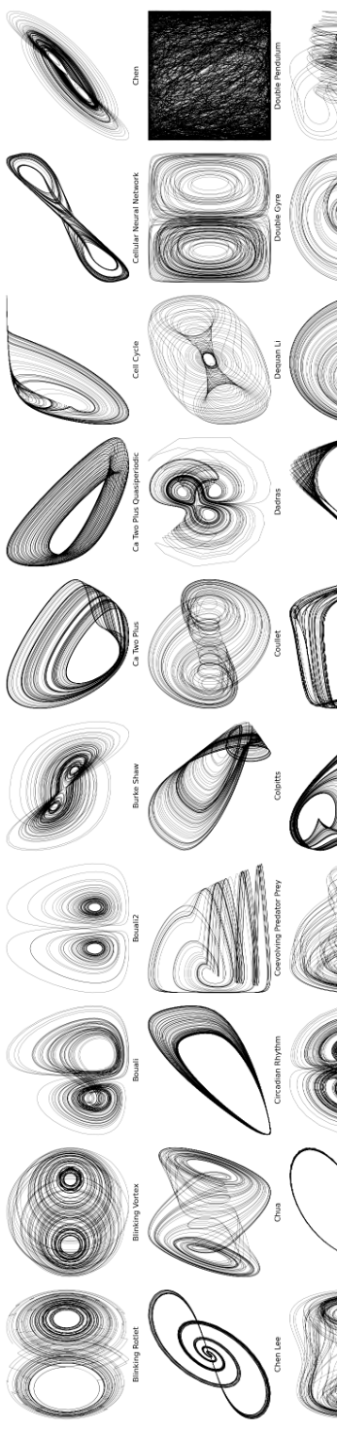
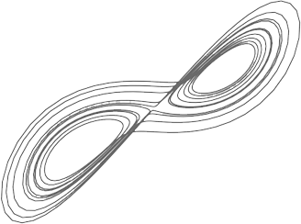
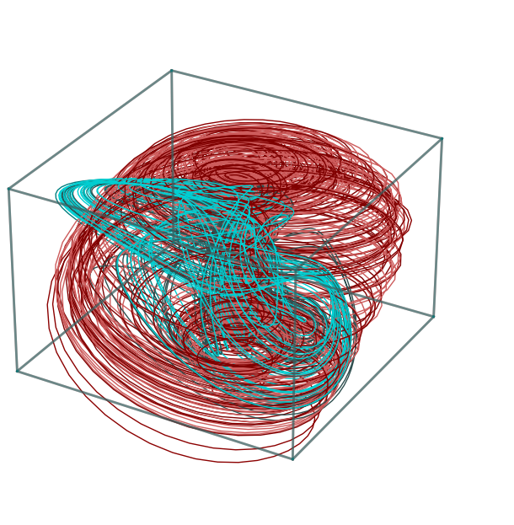
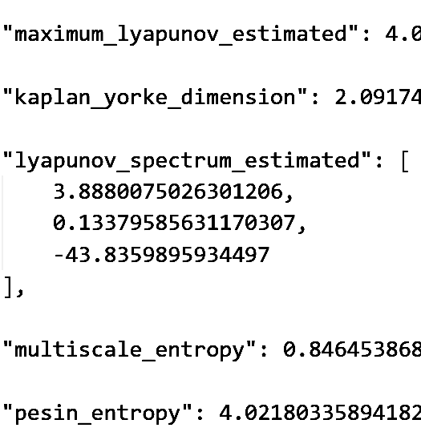
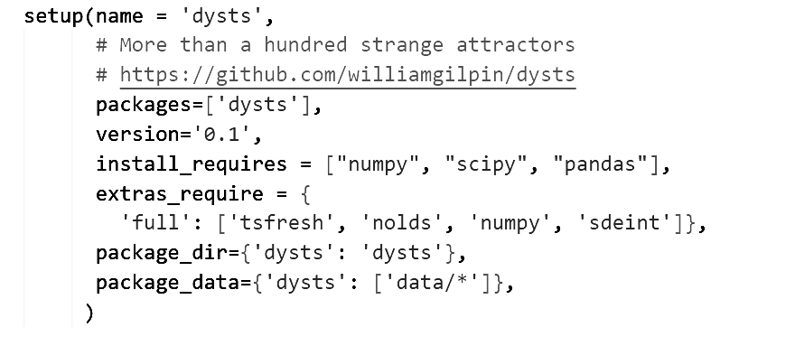
DATA PREPARATION chaotic systems
lyapunov
exponent
lyapunov
exponent
normalization_B
normalization_A
frequency of dimensions
dimensional
analysis
UNIFORM
EVALUATION
number of dimensions
more planes, more regions

Slide 5
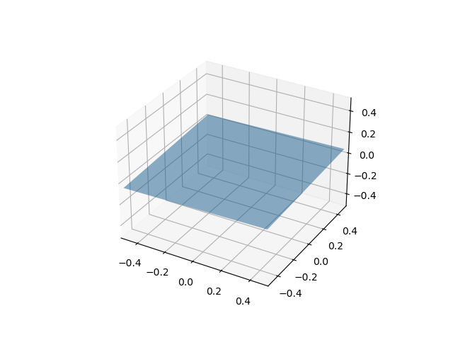
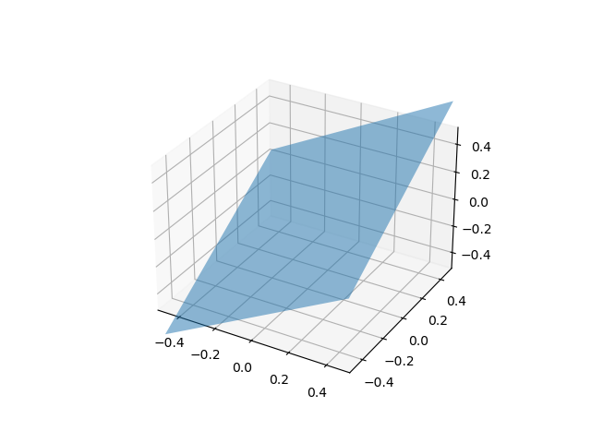
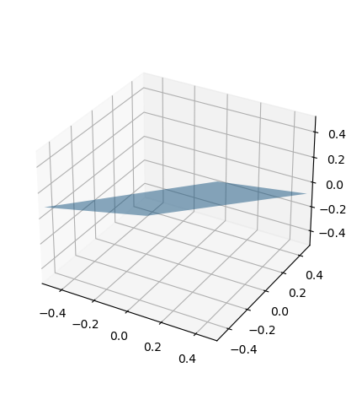
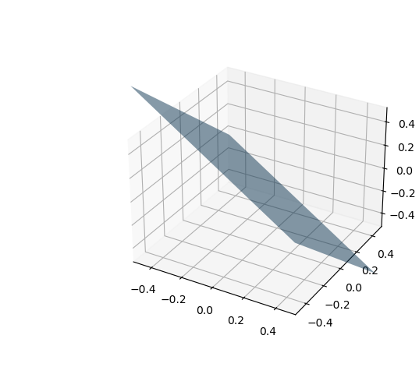
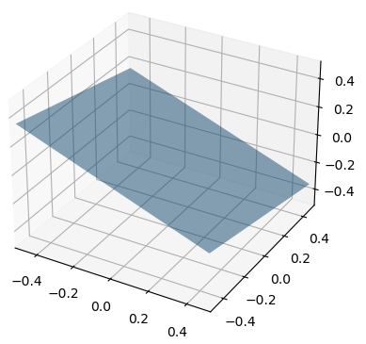
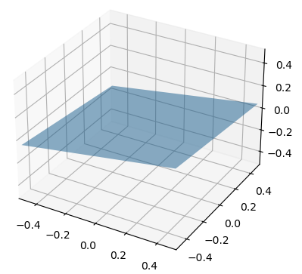
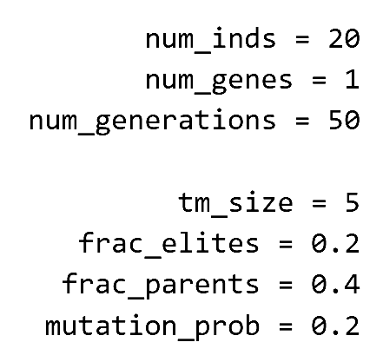
MODEL SELECTION evolutionary algorithm
Individual: a solution candidate, which is a plane hence, has one gene and a fitness value.
Gene: consist of phenotypes of the individual, for our case rotation (r, theta, phi ).
Population: a group of individuals to be selected, reproduced and mutated.
Elites: partition of population which are directly moved to the next generation.
Parents: partition of population eligible for reproduction.
Children: generated through crossover of genes from parents.
Rest: Rest of the population, mutated and moved to the next generation.
Terminal
Justification
Start
Initialize
Calculate Fitness
Process operations :
Selection, Crossover
Mutation
Generate new population
End
Replace population
RANGE OF SOLUTIONS - SCALABLE DIMENSIONS/PLANES - NO DATA LABELING - FAST

Slide 6
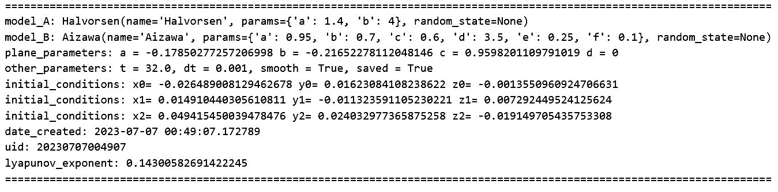
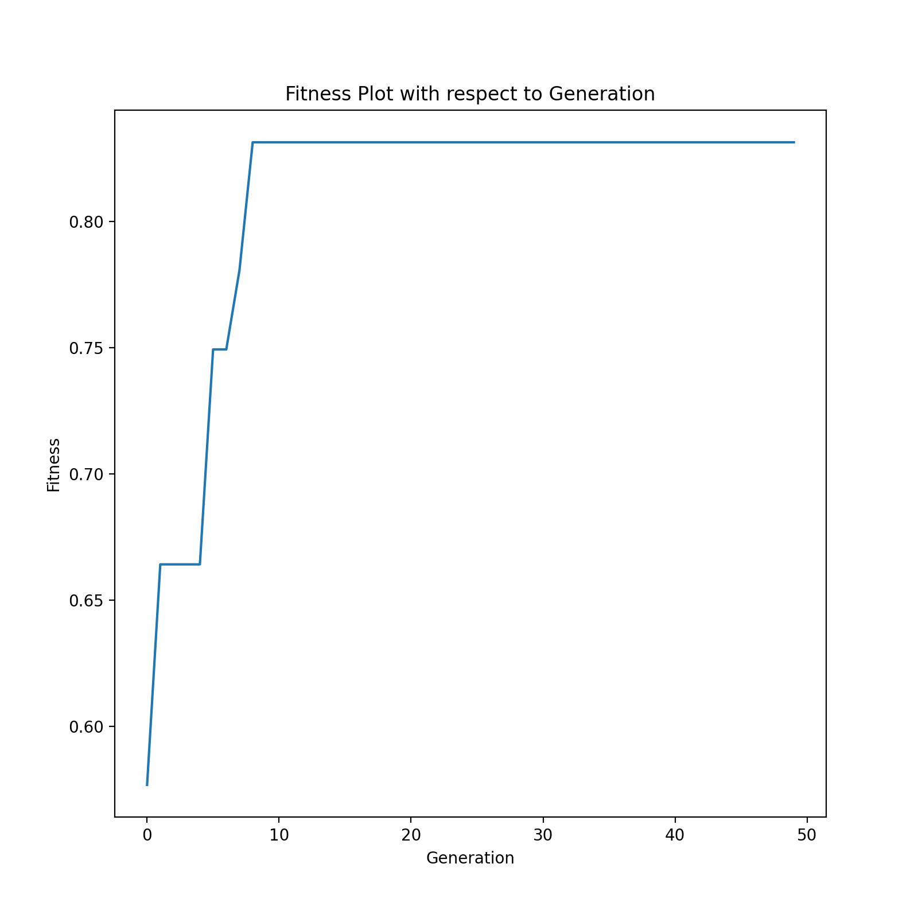
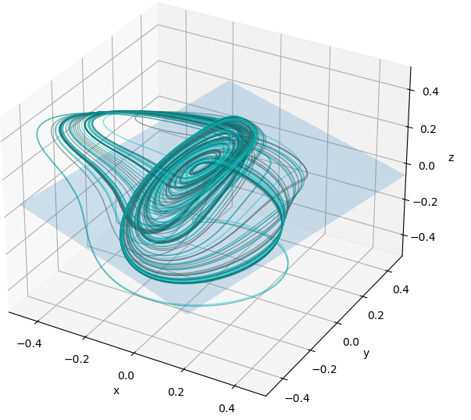
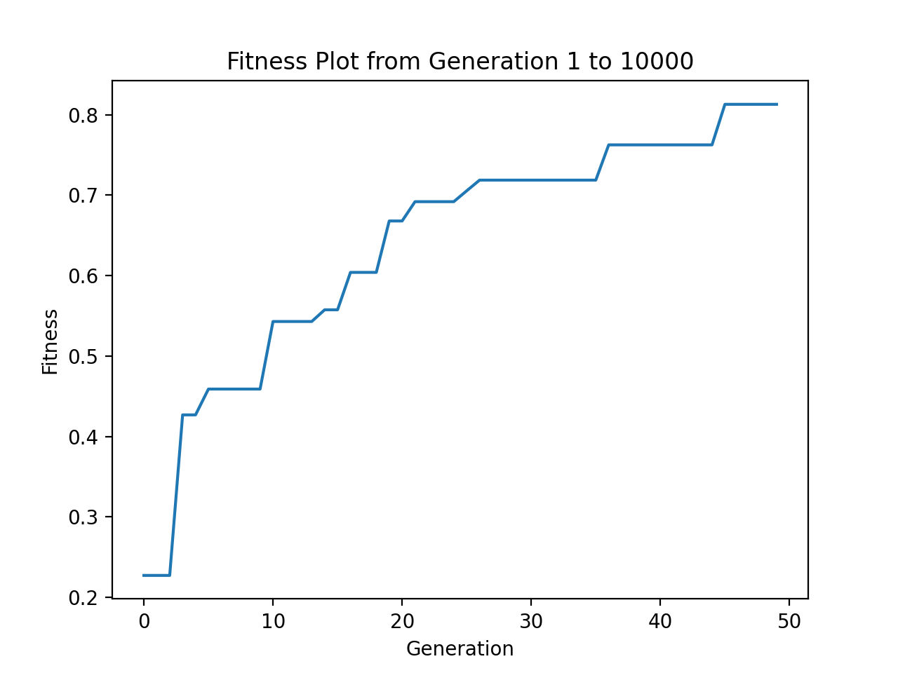
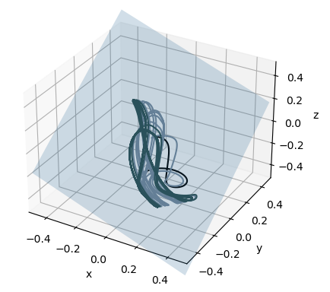
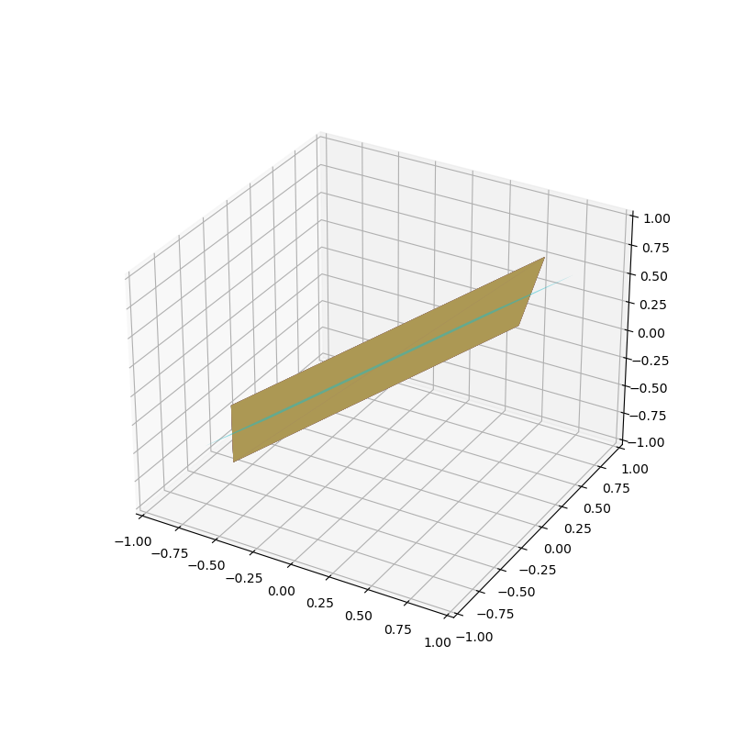
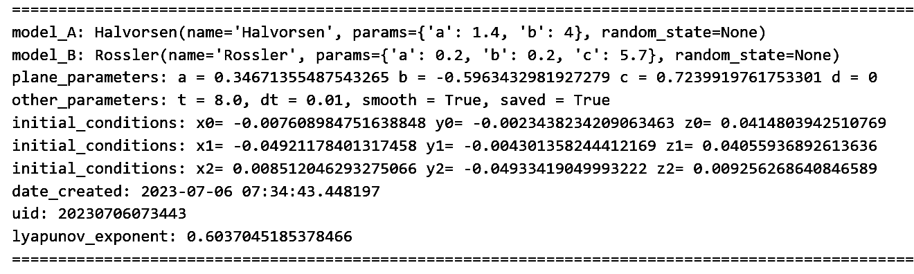
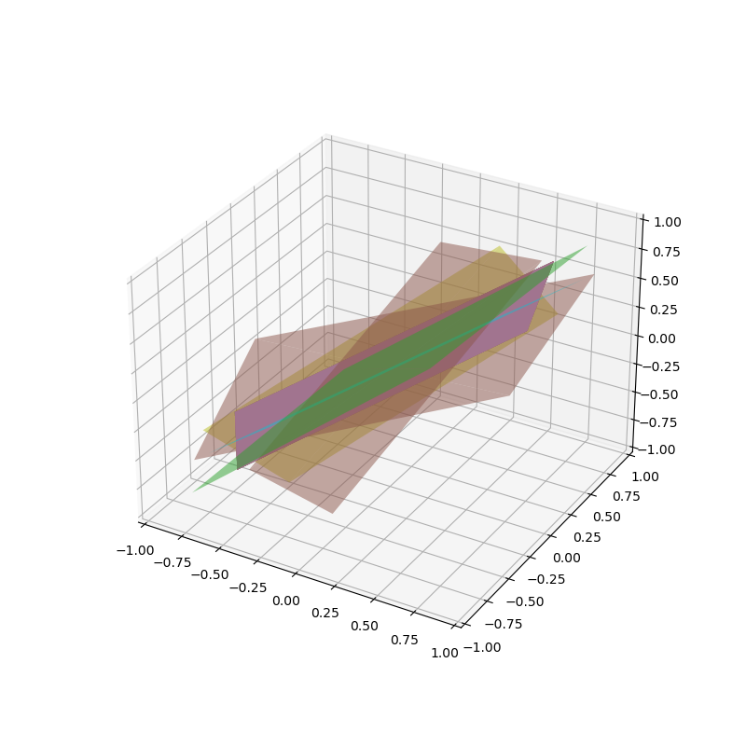
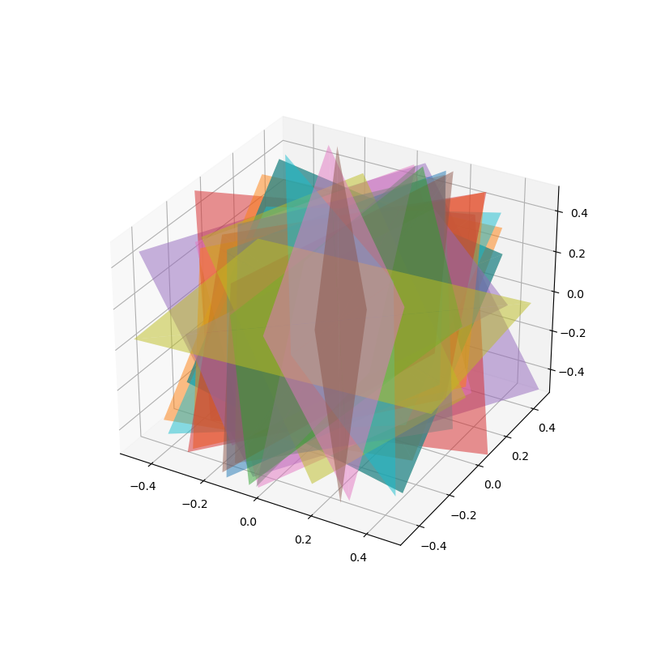
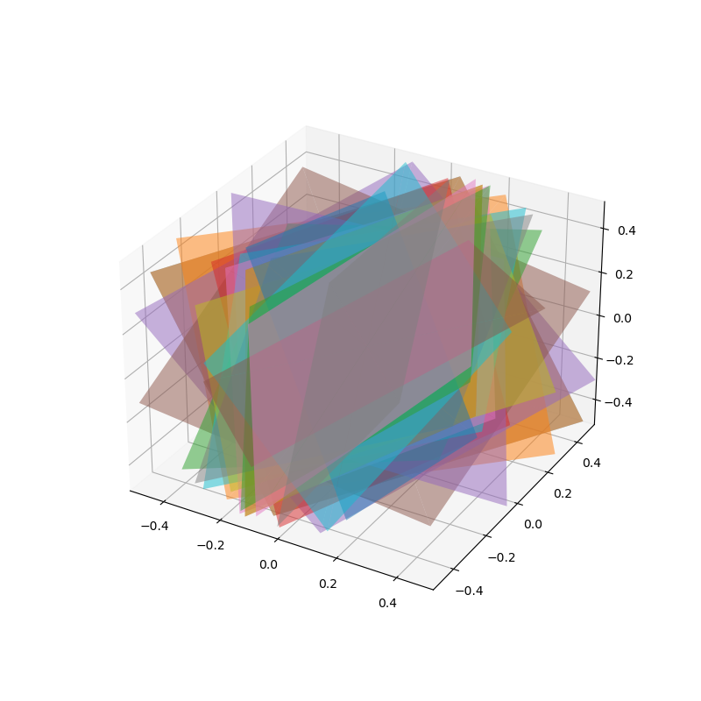
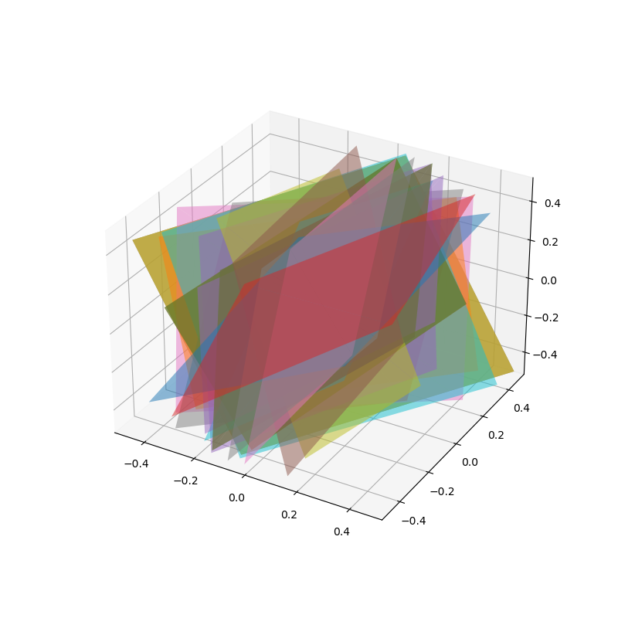
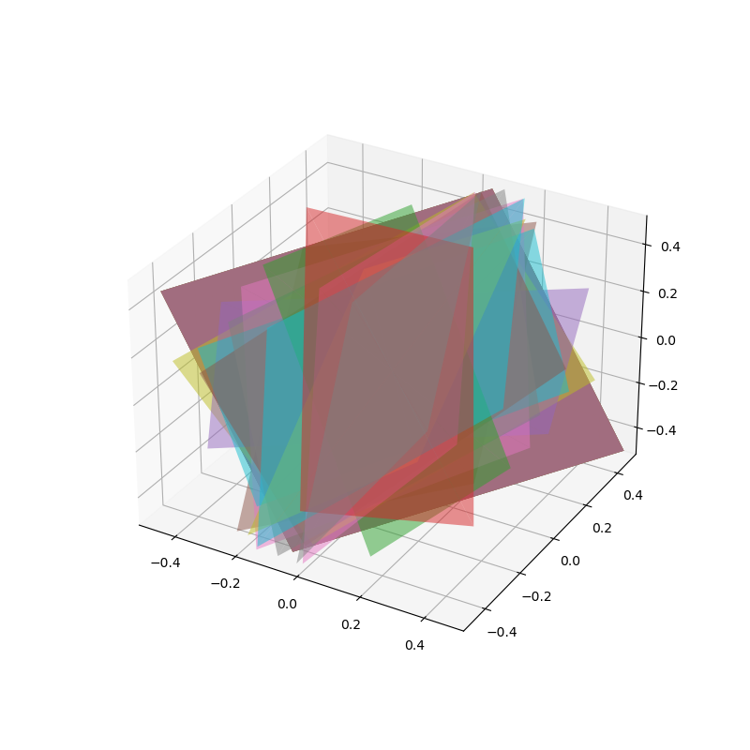
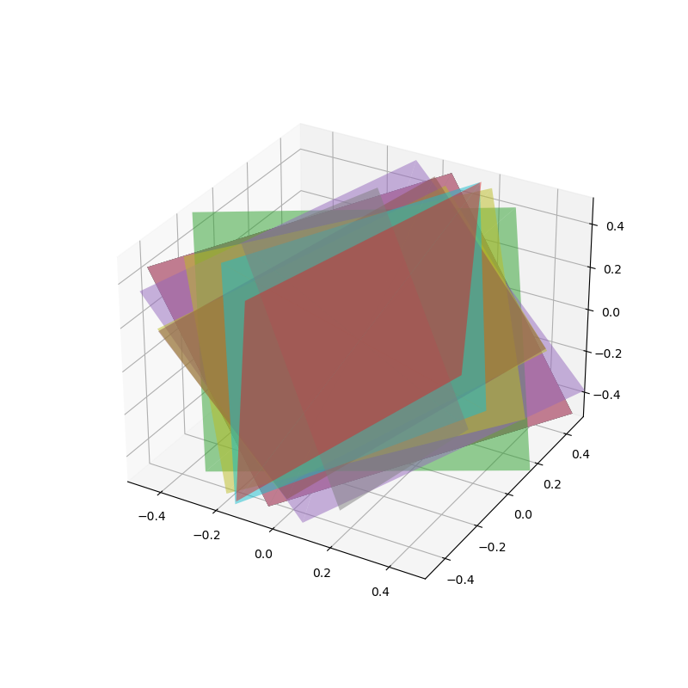
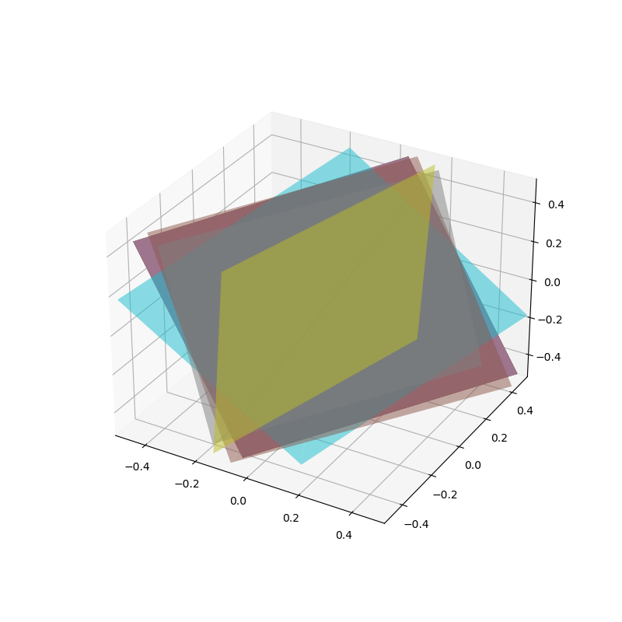
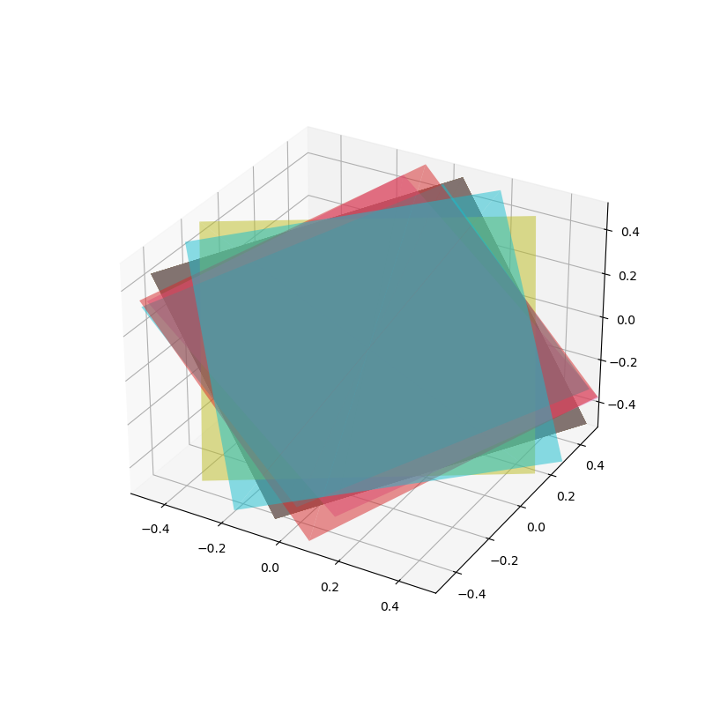
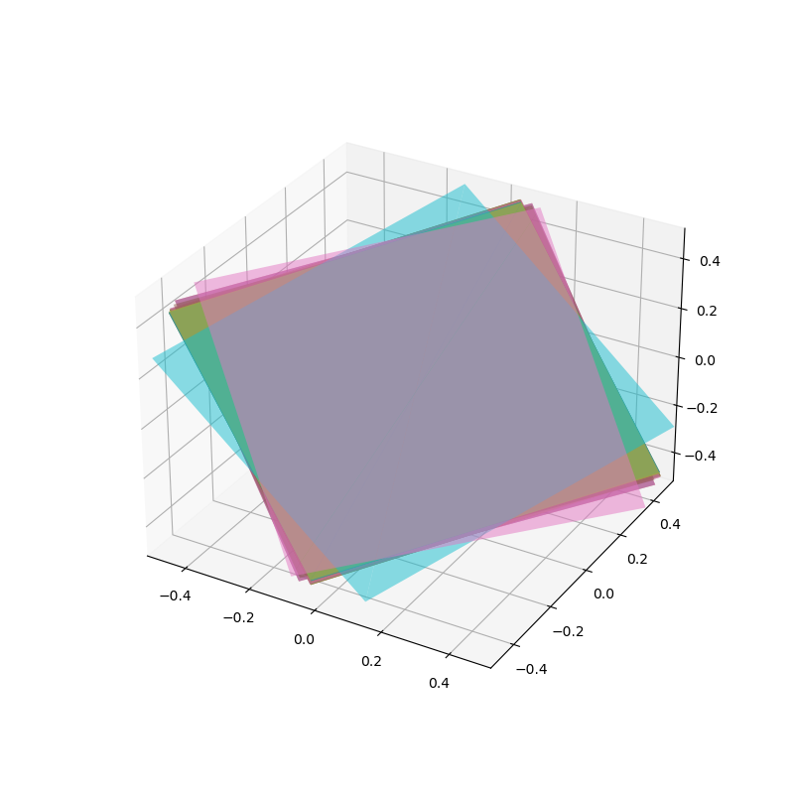































RESULTS evolutionary algorithm
RUNTIME
50 generation
600 -1200
seconds

Slide 7




















RESULTS evolutionary algorithm
FUTURE WORKS
Experimenting with higher dimensions
sphere/oblique surface instead of plane
multiple planes and increased regions
https://youtu.be/WuO1O8Ao5GU

Slide 8
References
Berenice Abbott, “A Bouncing Ball in Diminshing Arcs” (1958-1961), 54.6 × 45.7 cm, photograph mounted on
Masonite with no glazing (Berenice Abbott Collection, MIT Museum. Gift of Ronald and Carol Kurtz
© Getty Images/Berenice Abbott)
Sajad Jafari, J.C. Sprott, S. Mohammad Reza Hashemi Golpayegani, Elementary quadratic chaotic flows with
no equilibria, Physics Letters A, Volume 377, Issue 9, 2013, Pages 699-702, ISSN 0375-9601,
https://doi.org/10.1016/j.physleta.2013.01.009.
"Lyapunov exponent." Wikipedia, The Free Encyclopedia. Wikipedia, The Free Encyclopedia, 16 Jan. 2023. Web. 7 Jul.
2023.
"Lorenz system." Wikipedia, The Free Encyclopedia. Wikipedia, The Free Encyclopedia, 26
Jun. 2023. Web. 7 Jul. 2023.
Plane. from Wolfram MathWorld. https://mathworld.wolfram.com/Plane.html
Thank you for your time.

